Slide 1
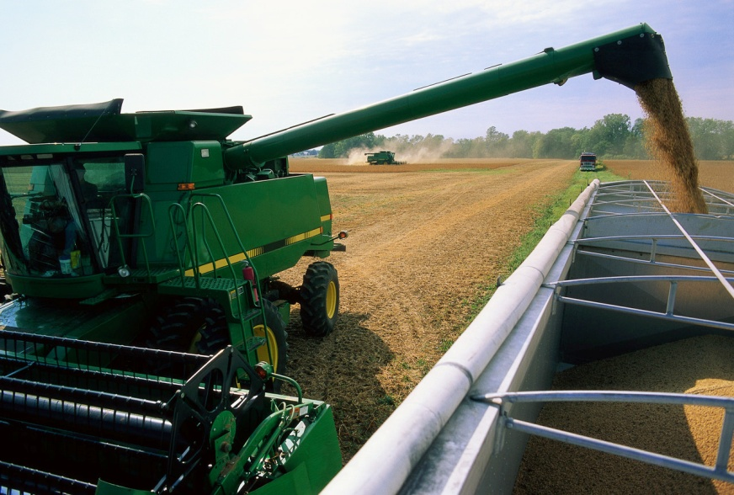
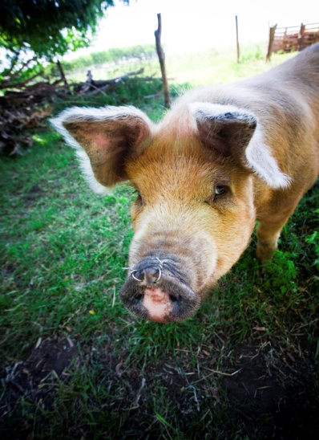
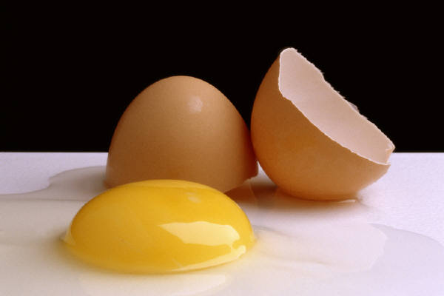
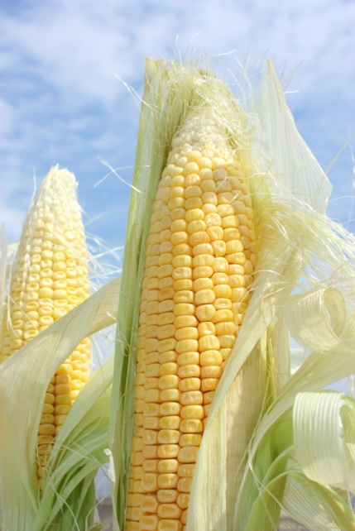
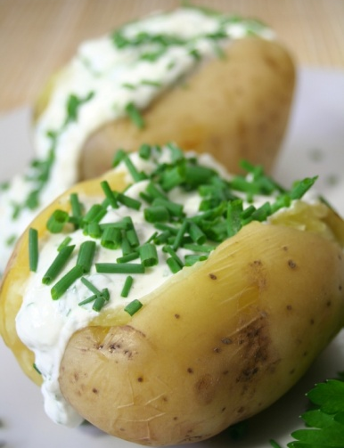
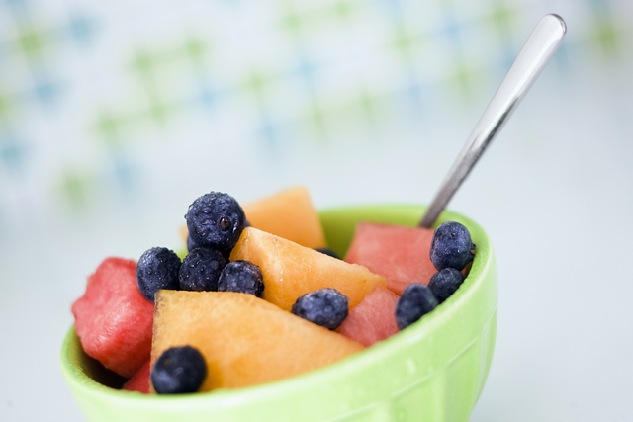
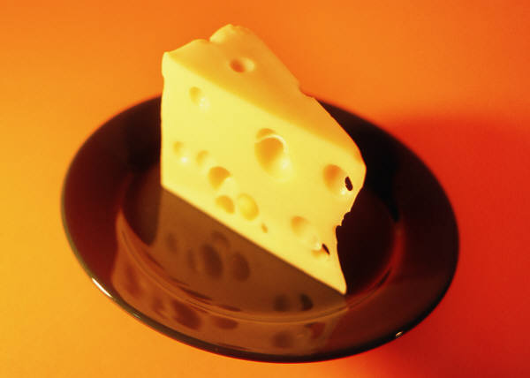
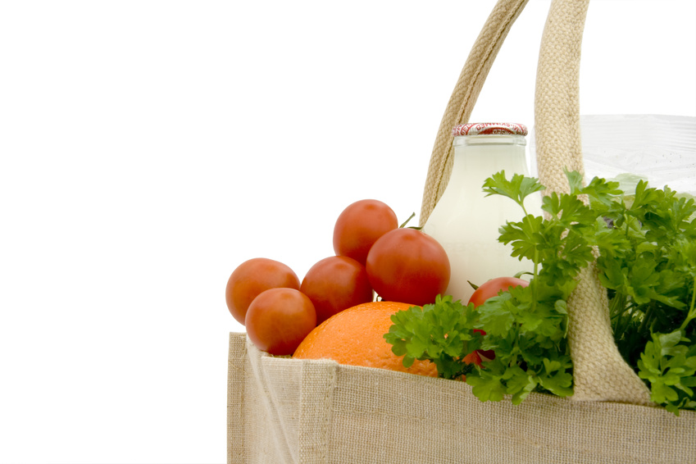
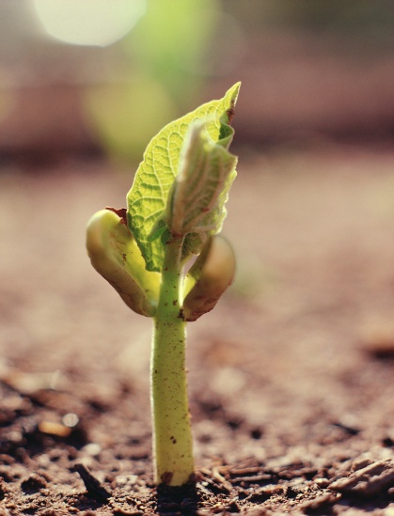
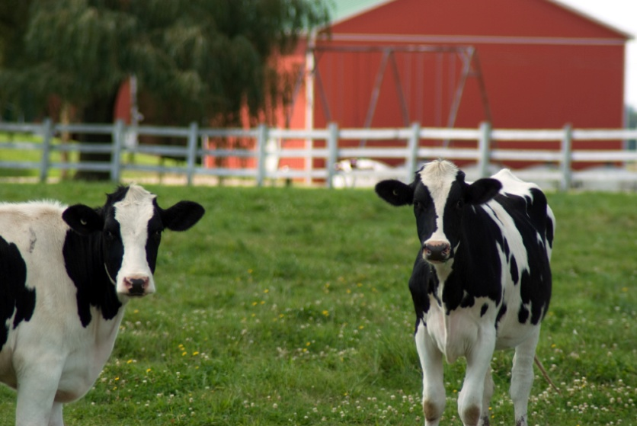
Notes:
Soil to Spoon
National Association of Conservation Districts (NACD)
2012 Poster Contest Theme
2012 Education Materials Theme
Stewardship Week April 29- May 6, 2012

Slide 2
Soil to Spoon
National Association of
Conservation Districts (NACD)
2012
Poster Contest Theme
And Stewardship Theme
Notes:
Soil to Spoon Is the theme for the 2012
National Association of Conservation Districts (NACD) poster contest. It is also used for the 57th year of NACD Stewardship Week held the last Sunday in April to the first Sunday in May each year.
April 29-May 6, 2012.
The poster contest is co-sponsored by the National Association of Conservation Districts and the NACD Auxiliary – which is comprised of spouses of NACD leaders across the nation.
What pictures did you see in the previous slide?
What are the importance of each of the photos?
1- combine – harvesting crop to make into food product
2 – Pig – food product for those who like pork products
3 – Egg – Egg from chickens used for breakfast or in cookies and cakes and other products
4 – Bake Potato – grown in the soil and used with a variety of meal
5 – Bowl of fruit – part of the food group we need each day
6 – Cheese made from milk from a dairy cow
7 – Milk, orange and tomato in bag from store
8 – Plant growing in soil to be harvested to make food products
9 – Dairy cows each grass which grows in the soil – Dairy cows produce milk to make cheese, milk, ice cream and a variety of other products.

Slide 3
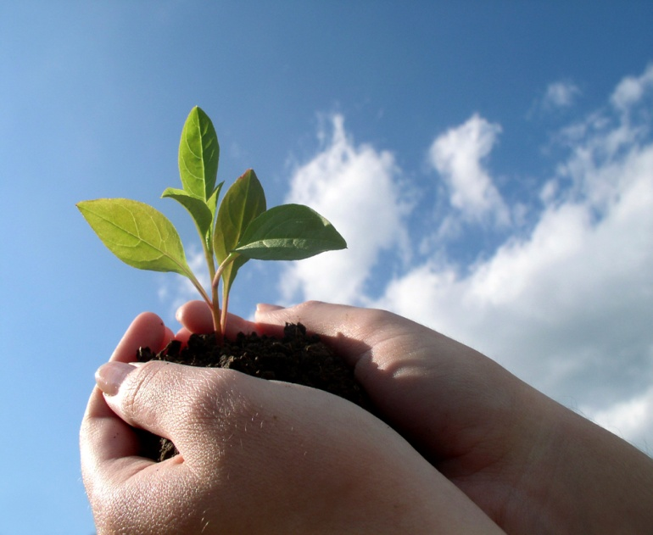
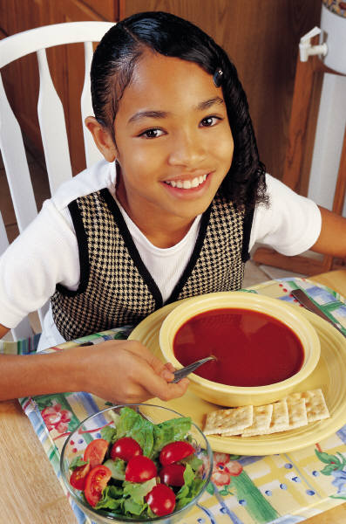
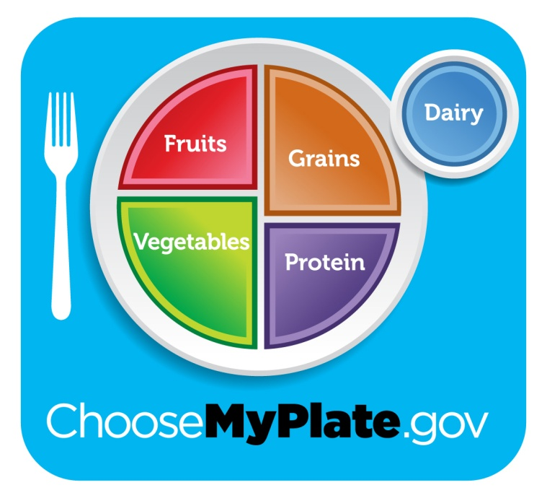
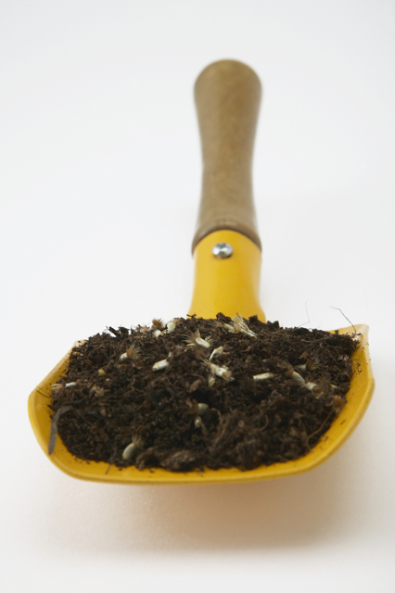
Why do you
need to know
where your food
comes from?
Notes:
3
Why do you need to know where your food comes from?
(Have students list ways)
Should mention:
1) We eat food everyday.
2) Some people think food comes from the grocery store.
And never think how it got there.
3) Getting food to you involves lots of different kinds of jobs.
And more….

Slide 4
What kinds of food do you need to eat each day?
Notes:
4
What kinds of food do you need to eat each day?
(CLICK for food plate to come on screen)
Fruits
Grains
Vegetables
Protein
Dairy
These are all important to your daily nutrition

Slide 5
What do these foods have in common?
Notes:
What do these foods have in common?
(CLICK for soil picture to come on screen)
They all have a connection to the soil.

Slide 6
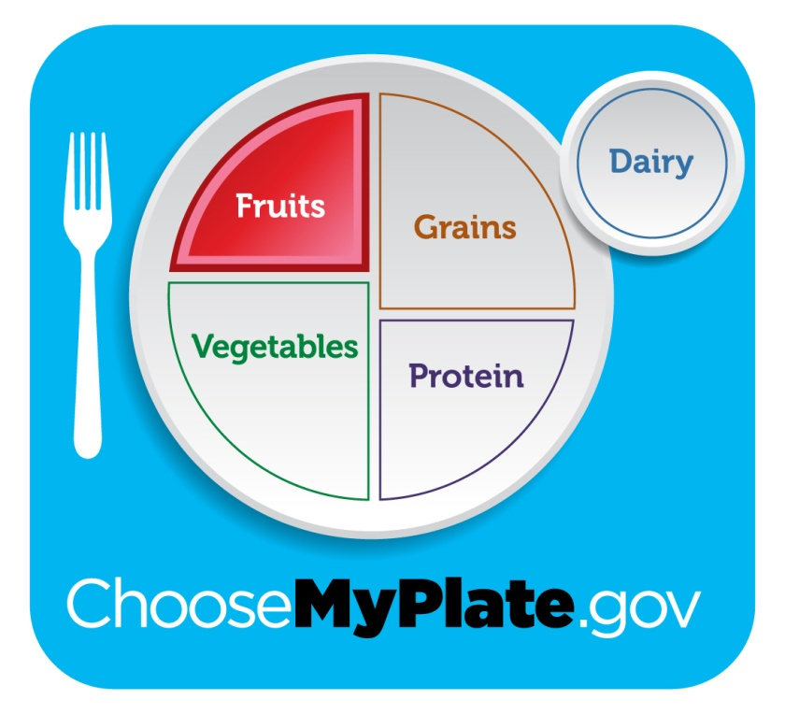
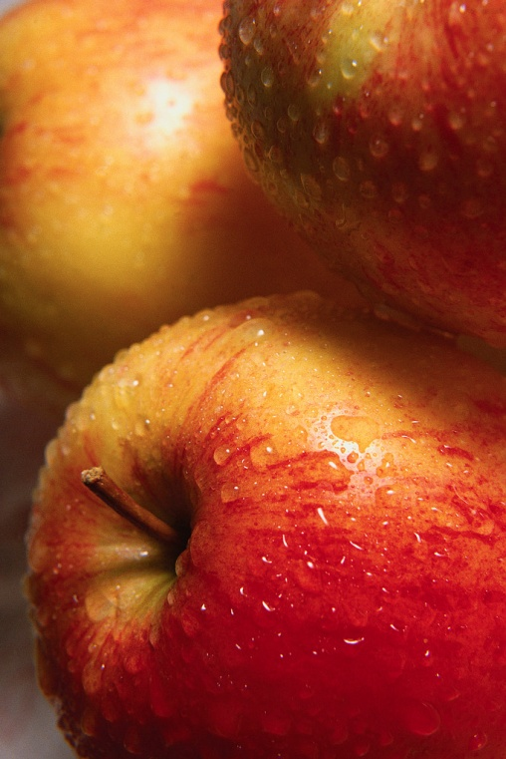
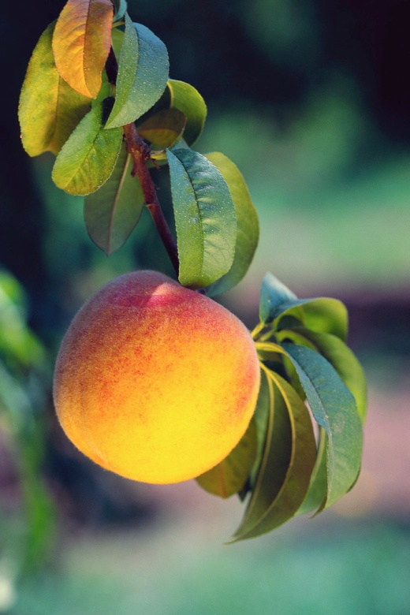
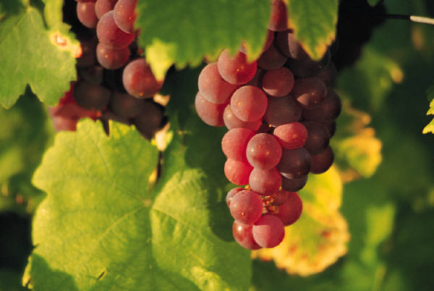
Fruits
Notes:
6
Fruits – some examples are:
Are part of your daily food needs.
Apples (CLICK)
Grapes (CLICK)
Peaches (CLICK)

Slide 7
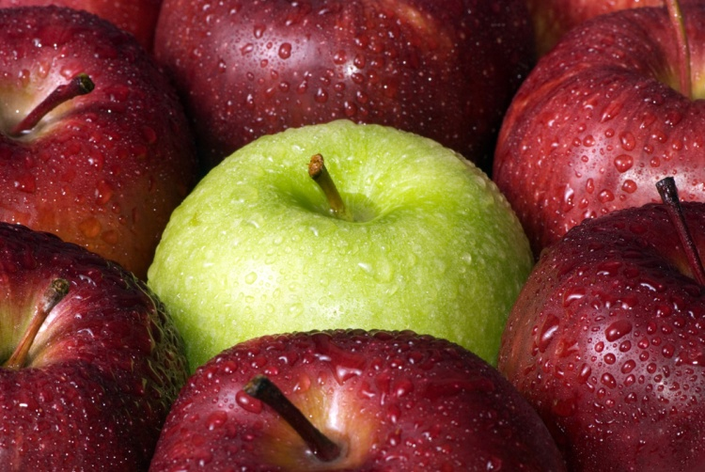
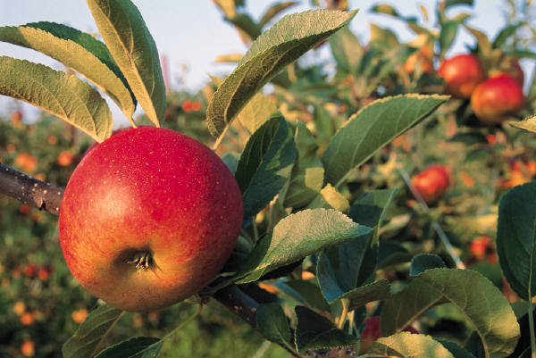
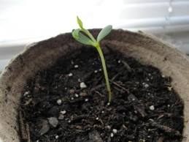
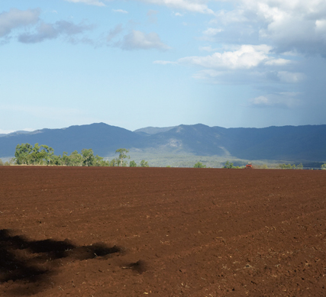
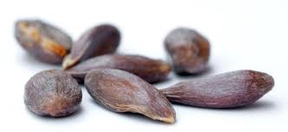
Trace the apple back to the soil
Notes:
7
Trace the apple back to the soil. (Click)
Apples are so good for you. We buy apples from the store, or you can buy or pick them from an apple orchard. (Click) (Click)
The apple grows on an apple tree. (Click)(Click) The apple tree starts out as a little seedling. (Click)(Click) You have to plant an apple seed (Click) (Click) (Click) and the seed has to be planted in the ?? (Click)
SOIL!

Slide 8
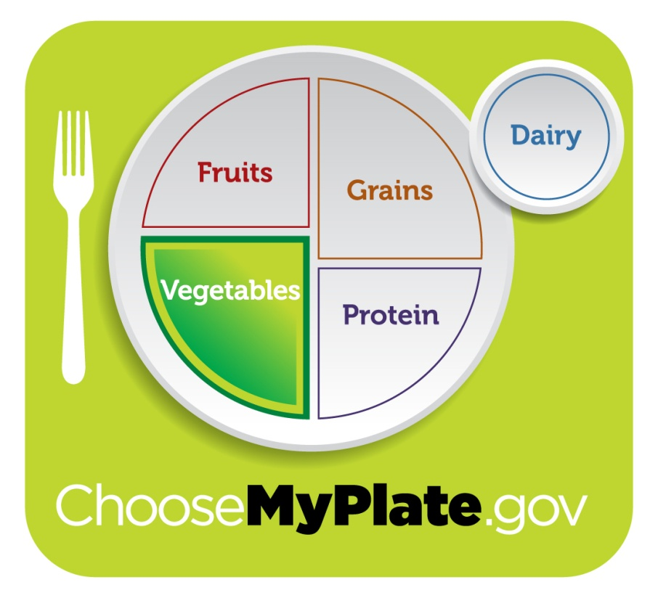
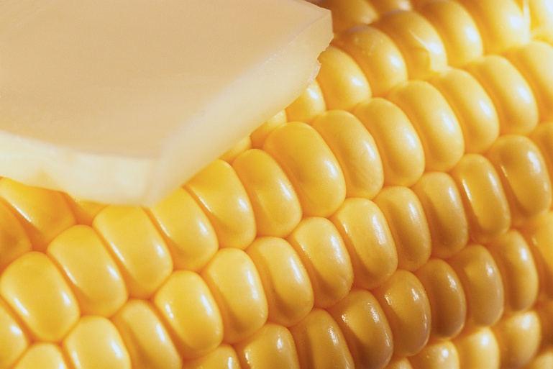
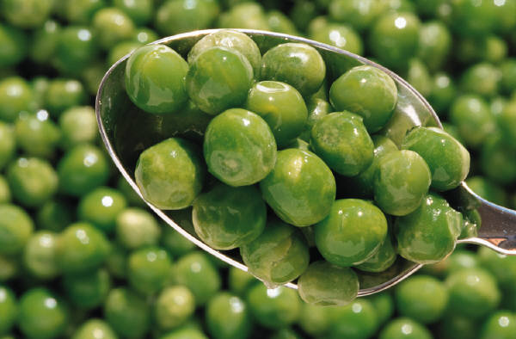
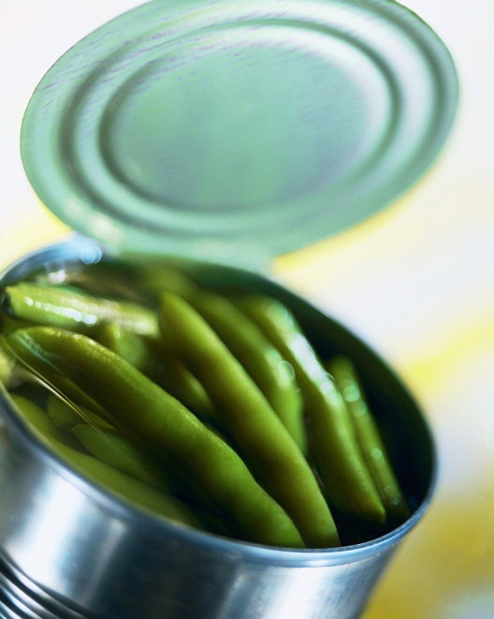
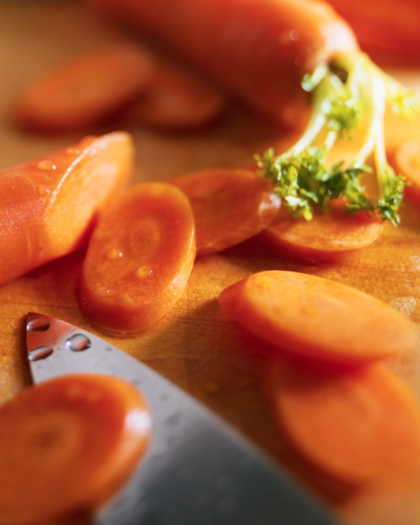
Vegetables
Notes:
8
Vegetables – some examples are:
You might have during the day for lunch or supper
Sweet Corn
Green Beans
Carrots
Or Peas
Which one is your favorite?

Slide 9
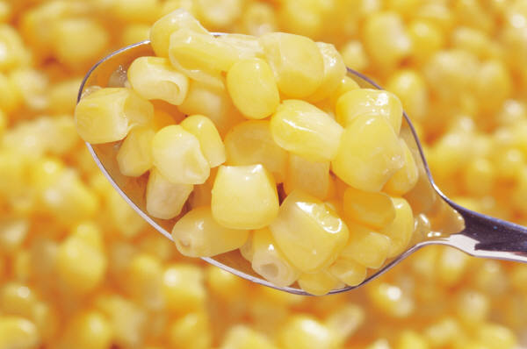
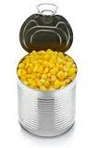
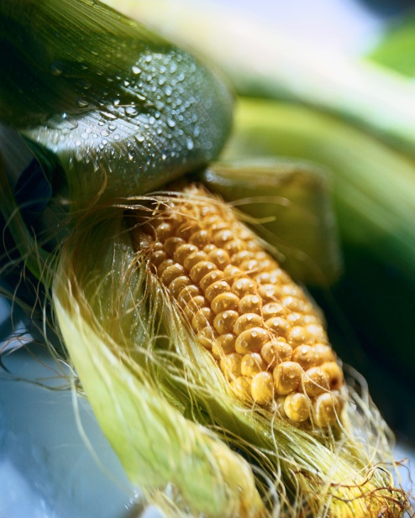
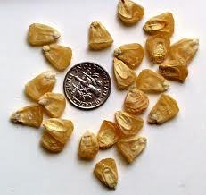
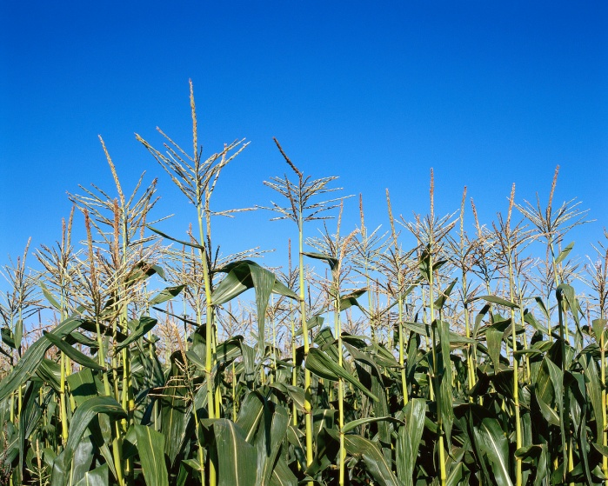
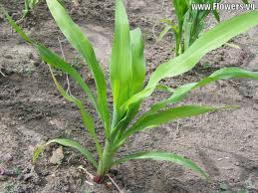
Trace the corn back to the soil
Notes:
9
Trace the corn back to the soil.
You sometimes get corn for one of your meals. (Click) (Click) A spoonful of corn is very good! (Click) (Click) How did that corn get in the can?? (Click) (Click) It had to grow on a plant called a corn stalk (Click) (Click) Sweet corn is usually shorter than field corn (Click) (Click) Sweet corn starts out as a small seedling (Click) (Click) and you have to plant sweet corn seeds for the seedling to grow. And where do you plant the sweet corn seed? (Click) (Click) in the SOIL!

Slide 10
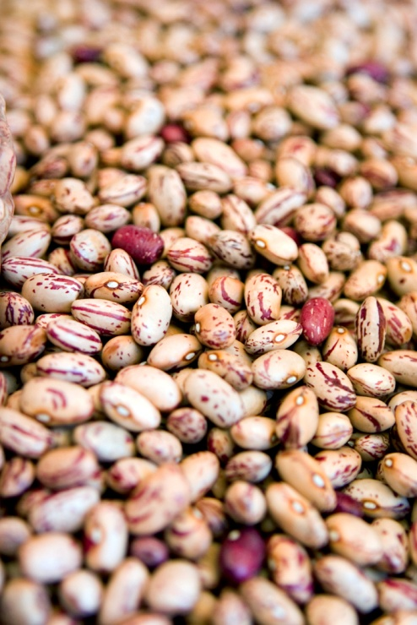
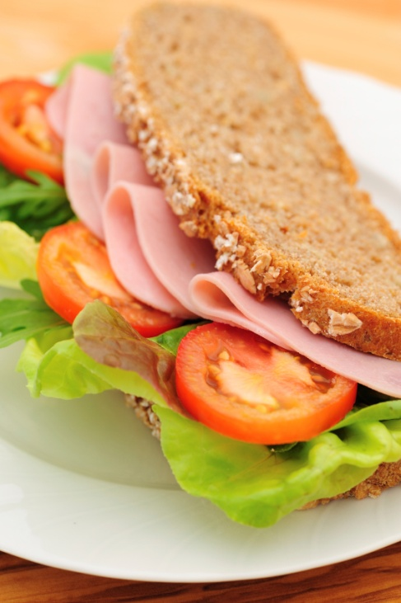
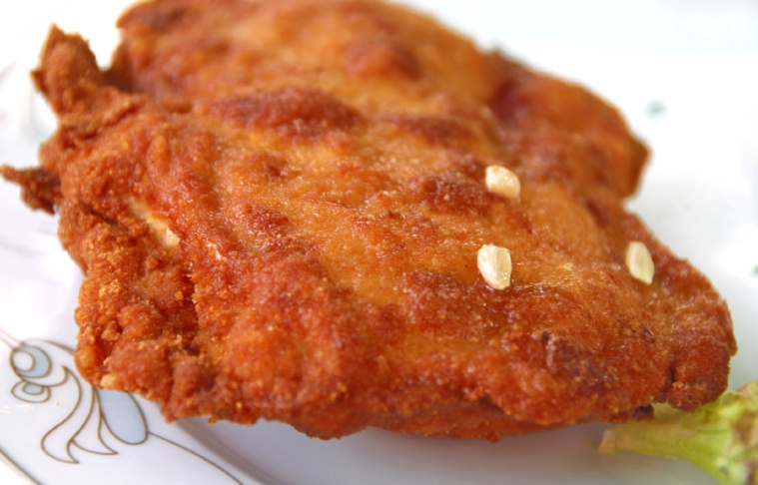
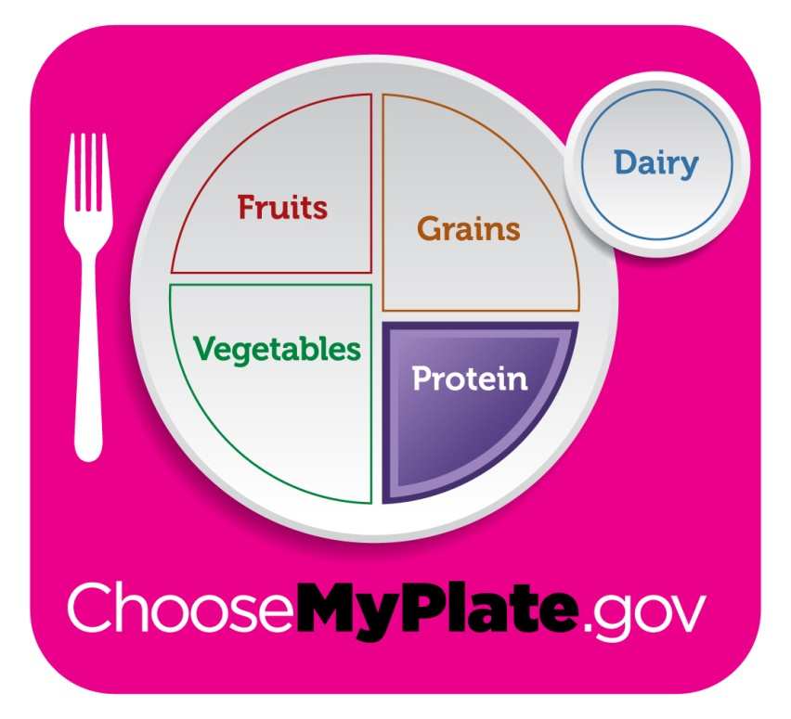
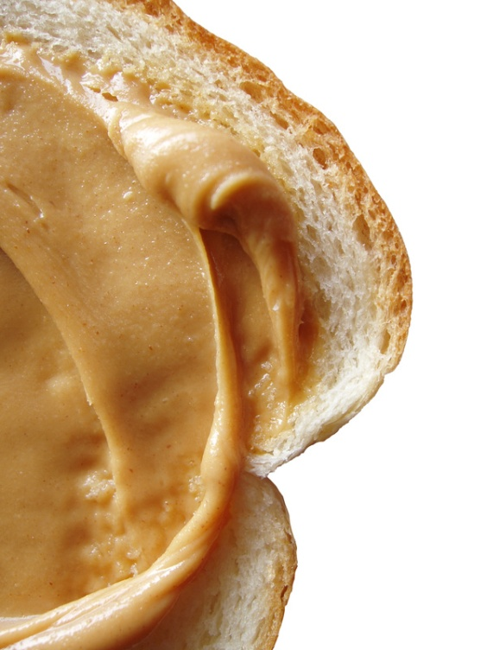
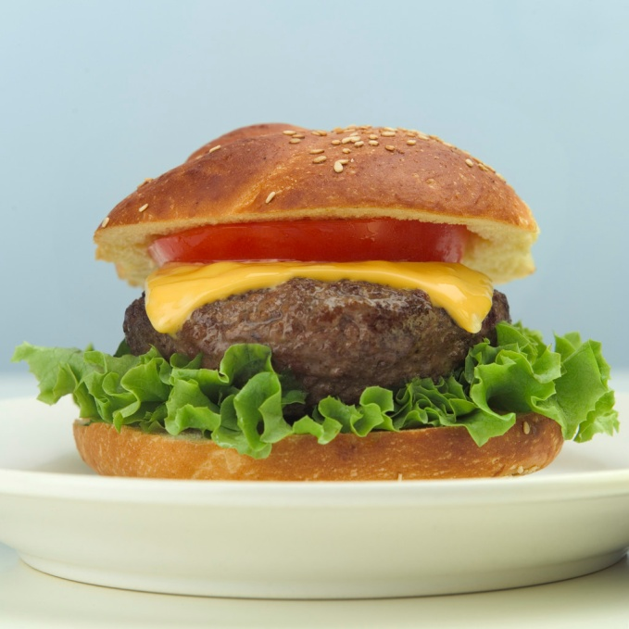
Protein
Notes:
10
Proteins cover many types of food.
Pinto beans (CLICK)
Peanut Butter (CLICK)
Ham (CLICK)
Ground Beef Hamburger (CLICK)
Chicken (CLICK)
And many more.

Slide 11
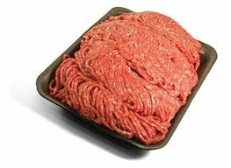
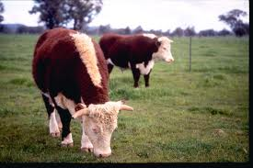
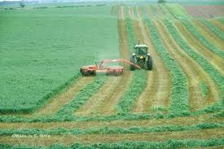
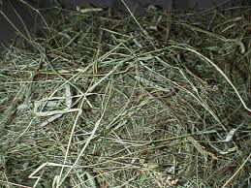
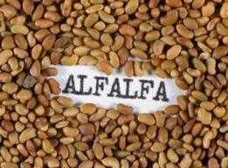
Trace the beef back to the soil
Notes:
11
Beef in the protein part of the nutrition plate. Trace the beef back to the soil.
Many people love hamburgers! Do you think we can trace the hamburger back to the soil? A cooked hamburger comes from (Click – Click )ground up beef which comes from (Click – Click ) beef cattle who love to eat (Click – Click ) hay! Hay is grown in (Click – Click ) fields and harvested using a tractor, mower and hay rake! The farmer has to (Click – Click ) plant alfalfa seeds to grow alfalfa hay. And the seed has to grow in the ??? (Click)

Slide 12
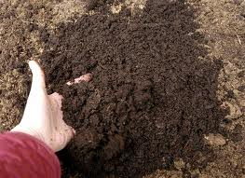
SOIL
Notes:
12
In the soil!

Slide 13
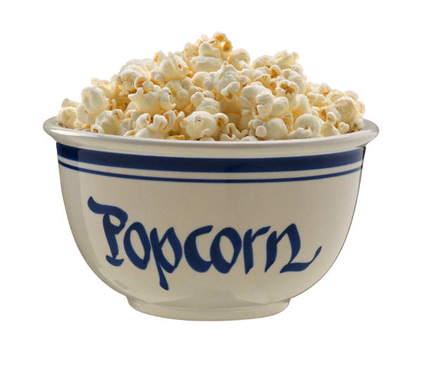
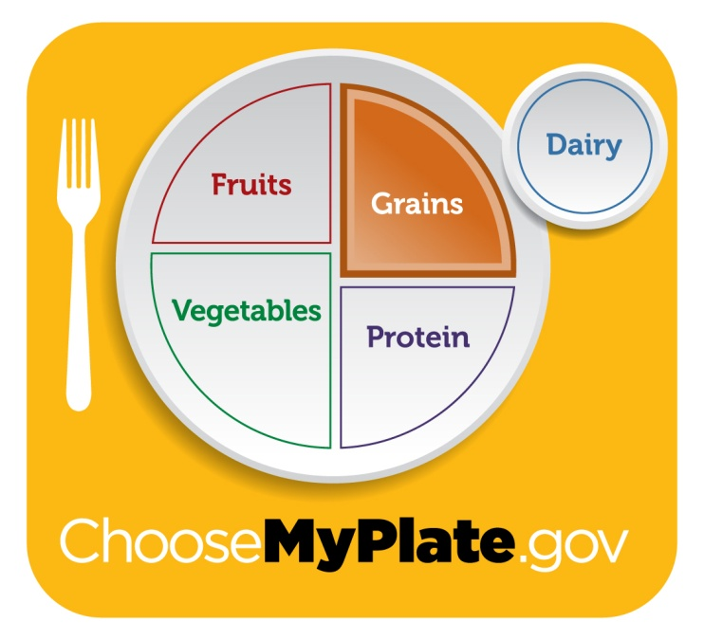
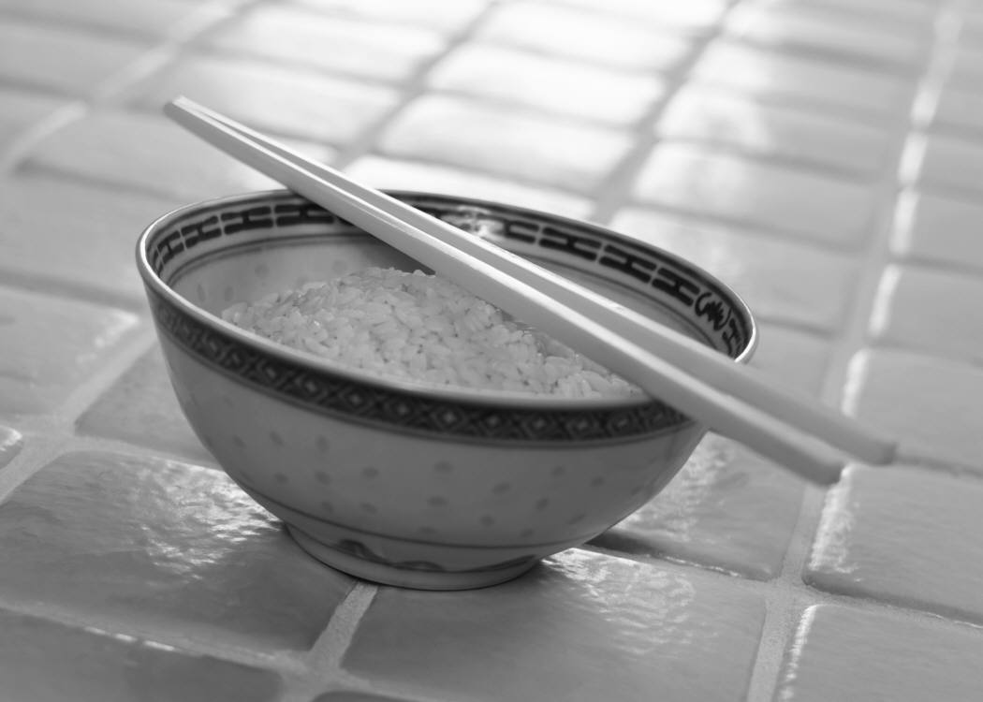
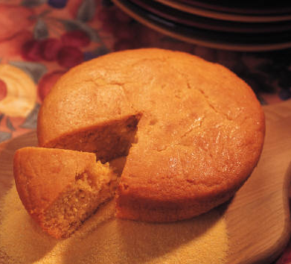
Grains
Notes:
13
Grains: Some examples are
Whole Wheat Bread (CLICK)
Popcorn (CLICK)
Corn Bread (CLICK)
Rice (CLICK)

Slide 14
Trace the bread back to the soil
Notes:
14
Lets trace the bread back to the soil. Here are a few of the steps. It actually takes many steps to produce a product.
Bread is great for toast or for sandwiches. Bread is made from flour.
The flour is ground from wheat. Which comes from a wheat grown in a field. The wheat is harvested by a combine.

Slide 15
Dairy
Notes:
15
Dairy – some examples are
Milk (CLICK)
Cheese (CLICK)
Yogurt (CLICK)

Slide 16
Trace the milk back to the soil
Notes:
16
Can you trace the milk back to the soil?
Milk comes from what kind of animal?? That’s right (Click – Click ) a dairy cow! And dairy cows, just like Beef cows like to eat what?? (Click – Click ) hay! Hay is grown in (Click – Click ) fields and harvested using a tractor, mower and hay rake! The farmer has to (Click – Click ) plant alfalfa seeds to grow alfalfa hay. And the seed has to grow in the ??? (Click – Click ) SOIL!

Slide 17
Your school lunch
Notes:
17
What is one of your favorite school lunches?
Pick something we have not talked about and trace it back to the soil!

Slide 18
Food products in your community
Notes:
18
Food products in your community.
Is there any kind of food that grows near you?
Have you seen any these?
Apples?
Wheat?
Dairy Cows?
Vegetables?
Do you grow vegetables at your house?
What kind? (Take 3 answers)
Think of the food that you eat each day. Each one of those foods has a connection to the soil.
** If time – trace each food back to the soil. Can use photos of typical food and put on front board and put their stages traced back to the soil.

Slide 19
Gardening and Edible Landscaping
Notes:
Gardening is a great way to learn how food grows. If you don’t have room for a garden – many people are (Click) designing edible landscaping around their homes or apartments. Instead of flowers plants things you can eat! (Click) You can even grow vegetables in containers.

Slide 20
Conservation and Your Food
Notes:
We have talked about how important soil is to producing the food you eat each day. Farmers and Ranchers take great care of the soil so that we can eat everyday. One way is to have conservation practices to keep the soil in place so that it does not wash away when it rains or too windy.
These are called Best Management Practices. Some Best Management practices are: Windbreak, Grass Waterway and Buffer Strip.
(discuss each one and add additional ones that are part of your area if you wish)

Slide 21
What kinds of careers are related to food production and conservation of the land?
Notes:
21
What kinds of careers are related to food production and conservation of the land?
The list is very long! Here are a few
Farmer
Rancher
Chef
Truck Driver
Soil Scientist
Conservation Plan designer
(Add additional if you wish)

Slide 22
ADD PICTURES FROM YOUR COMMUNITY
Examples:
Master Gardener or Junior Master Gardner programs, local farmers and ranchers, food processing business. Grain elevators, meat markets, etc.
Notes:
22
ADD PICTURES FROM YOUR COMMUNITY
Examples:
Master Gardener or Junior Master Gardner programs, local farmers and ranchers, food processing business. Grain elevators, meat markets, etc.

Slide 23
What can you do to learn more about where your food comes from?
Talk to people in your community who are farmers or ranchers.
Talk to people who study soils.
Talk to FFA members.
Research topics about where your food comes from.
Talk to people who garden in your community.
Notes:
23
What can you do to learn more about where your food comes from?
Talk to people in your community who are farmers or ranchers.
Talk to people who study soils.
Talk to FFA members who study for livestock judging or soil judging or other agri-science topics.
Research topics about where your food comes from.
Talk to people who garden in your community.

Slide 24
2012 Soil to Spoon POSTER CONTEST
Notes:
24
2012 Soil to Spoon POSTER CONTEST
National NACD Poster Contest Sponsored by
NACD and NACD Auxiliary
Your local poster contest is sponsored by: ____
Prize money _______

Slide 25
2012 Categories
Grades K-1
Grades 2-3
Grades 4-6
Grades 7-9
Grades 10-12
Notes:
25
2009 Categories
Grades K-1
Grades 2-3
Grades 4-6
Grades 7-9
Grades 10-12
(Update if your district or state contest is different)

Slide 26
Theme Title for Your Poster
Soil to Spoon
Discuss and share your
information with others!
Notes:
26
Theme Title for Your Poster
Soil to Spoon
Discuss and share your
information with others!
Design your posters using some of these ideas:
1) How does the food get from the soil to my spoon??
2) Select one product and follow it from the soil to your plate.
3) Who is responsible for producing the food I eat?
And more.

Slide 27
FOR YOUR LOCAL, AREA, STATE OR ADDITIONAL INFORMATION ABOUT YOUR DISTRICT
Notes:
27
FOR YOUR LOCAL, AREA, STATE Forestry Information AND OR ADDITIONAL INFORMATION ABOUT YOUR DISTRICT

Slide 28
Poster Ideas
Notes:
28
Poster Ideas (grade 4-6 student)
These are some past national poster contest winners
Additional posters at
http://nacdnet.org/education/contests/poster/

Slide 29
Poster Ideas
Notes:
29
Poster Ideas (Grade 2-3)
These are some past national poster contest winners
Additional posters at
http://nacdnet.org/education/contests/poster/

Slide 30
Poster Ideas
Notes:
30
Poster Ideas (Grade 10-12 student)
These are some past national poster contest winners
Additional posters at
http://nacdnet.org/education/contests/poster/

Slide 31
What makes a good Poster?
Attracts attention
Is simple and clear
Uses colors and
white space to
get and hold attention
Letters are large
enough to be easily read
Notes:
31
Attracts attention
Is simple and clear
Uses colors and white space to get and hold attention
Letters are large enough to be easily read
(Poster Grade K-1 Student)

Slide 32
When forming ideas for your poster
Research the topic of the theme
Brainstorm ideas and make a list
Use the theme as your title
Soil to Spoon
Notes:
32
Research the topic of the theme
Brainstorm ideas and make a list
Think of the theme and use the theme as your title
Soil to Spoon

Slide 33
Tips to remember
Don’t use too many words
Use a combination of illustrations and words
Be as neat as you can
Blend colors when using crayons or colored pencils
Depending on design leave white space on the poster
Make sure the poster is balanced
Notes:
33
Tips to remember
Don’t use too many words
Use a combination of illustrations and words
Be as neat as you can
Blend colors when using crayons or colored pencils
Depending on design leave white space on the poster
Make sure the poster is balanced

Slide 34
Tips to remember
Choose colors carefully. Note the following general guidelines:
- Black tends to be more formal, neat, rich, strong
- Blue is cool, melancholy
- Purple is considered royal, rich
- Yellow tends to be warm, light, or ripe
- Green is fresh, young, or growing
- White means clean, and neat
-Red attracts the eye, is high energy
- Orange attracts the eye
Notes:
34
Choose colors carefully. Note the following general guidelines:
- Black tends to be more formal, neat, rich, strong
- Blue is cool, melancholy
- Purple is considered royal, rich
- Yellow tends to be warm, light, or ripe
- Green is fresh, young, or growing
- White means clean, and neat
-Red attracts the eye, is high energy
- Orange attracts the eye

Slide 35
Tips to remember
Don't try to include too many ideas or activities on your poster.
A single message, clearly illustrated, is more effective .
Notes:
35
Don't try to include too many ideas or activities on your poster. A single message, clearly illustrated, is more effective

Slide 36
Things you should not do
Cover poster with lamination or other clear covering.
(Clear covering is OK if chalk type materials)
Use staples, tacks, or tape.
Use fluorescent posters.
Create a poster that is all words or a poster that is all pictures.
Notes:
36
Things you should not do
Cover poster with lamination or other clear covering
Use staples, tacks, or tape
Use fluorescent posters
Create a poster that is all words or a poster that is all pictures

Slide 37
Steps to follow when making a poster
Decide on information to include on the poster.
Research the theme topic.
Sketch out your idea.
Mark guidelines for lettering. (lightly)
Clean up the poster so it is neat. Erase any guidelines that are showing.
Notes:
37
Decide on information to include on the poster
Research the theme topic
Sketch out your idea
Mark guidelines for lettering (lightly)
Clean up the poster so it is neat. Erase any guidelines that are showing.

Slide 38
Steps to follow when making a poster
Turn poster in on time for judging.
Attach poster entry form on the back and be sure it is signed by a parent or guardian.
Entry must be contestant's original, hand done creation and may not be traced from photographs or other artists' published works.
Notes:
38
Steps to follow when making a poster
Turn poster in on time for judging.
Attach poster entry form on the back and be sure it is signed by a parent or guardian.
Entry must be contestant's original, hand done creation and may not be traced from photographs or other artists' published works.

Slide 39
Steps to follow when making a poster
Any media may be used to create a flat or two-dimensional effect (paint, crayon, colored pencil, charcoal, paper or other materials).
Poster size must be between 8.5" x 11" and 22" x 28". Or the size required by your local or state contest.
Notes:
39
Any media may be used to create a flat or two-dimensional effect (paint, crayon, colored pencil, charcoal, paper or other materials).
Poster size must be between 8.5" x 11" and 22" x 28". Or the size required by your local or state contest.

Slide 40
What your poster will be judged on
Conservation message—50 percent
Visual effectiveness—30 percent
Originality—10 percent and
Universal appeal—10 percent
Notes:
40
Conservation message—50 percent
Visual effectiveness—30 percent
Originality—10 percent and
Universal appeal—10 percent

Slide 41
FOR YOU TO ADD LOCAL, AREA, STATE INFORMATION ON DATES AND OTHER CONTEST INFORMATION
Notes:
41
For you to add local or area information on dates, contest and other information.

Slide 42
Visit
http://www.nacdnet.org/education/resources/
For additional information on
NACD Education Material on Forestry Habitat, Soil and Water
Teachers guide
Student booklets and more………………………..
Notes:
42
Visit
www.nacdnet.org
Stewardship & Education
For additional information on
NACD Education Material on Habitat, Soil and Water
Teachers guide
Student booklets
and more………………………..

Slide 43
Speech
Add information if you also hold a speech contest on the stewardship theme
Date of Speech contest
Open for grades
Length of speech
Contact Information
Notes:
43
To find information about how to conduct a speech contest visit:
http://www.nacdnet.org/stewardship/speech_essay_contest_ideas.pdf

Slide 44
Essay
Add information if you hold an Essay contest on the Stewardship theme.
Contest open to grades:
Essay length:
Due Date:
Essays entries are to be sent to:
Contact Information
Notes:
44
To find information about how to conduct an essay contest visit:
http://www.nacdnet.org/stewardship/speech_essay_contest_ideas.pdf

